Slide 1
Cloud ComputiNg Project
BuzzWorld- Engaging Quizz Platform
Presented BY:
Nidhi Jain
Radhika Bansal
Sakshi Bhardwaj

Slide 2

BuzzWorld
"Life is not a multiple-choice test, it’s an open book essay exam.”
We are creating a real-time website to ‘take an online quiz’ effectively and effortlessly having great features involved. This site accommodates attractive interfaces that are easily accessible and understandable by the users.

Slide 3
What Our Website Include??
Many prebuild quizzes on people interested subjects
Have an option to build or make their own quiz with their chosen questions and types of questions like Multiple Choice Questions, Fill in the blanks, etc.
It provides the top-notch availability to search for their interested topics of quiz.
It will provide the leading facility to the students as well as teachers to explore and enhance their learning by testing their knowledge.
Anyone can make their quiz by selecting the questions directly from the well known sites of google in time.

Slide 4

WebScrapping
Web scraping is the process of using bots to extract content and data from a website. Unlike screen scraping, which only copies pixels displayed onscreen, web scraping extracts underlying HTML code and, with it, data stored in a database. The scraper can then replicate entire website content elsewhere.

Slide 5
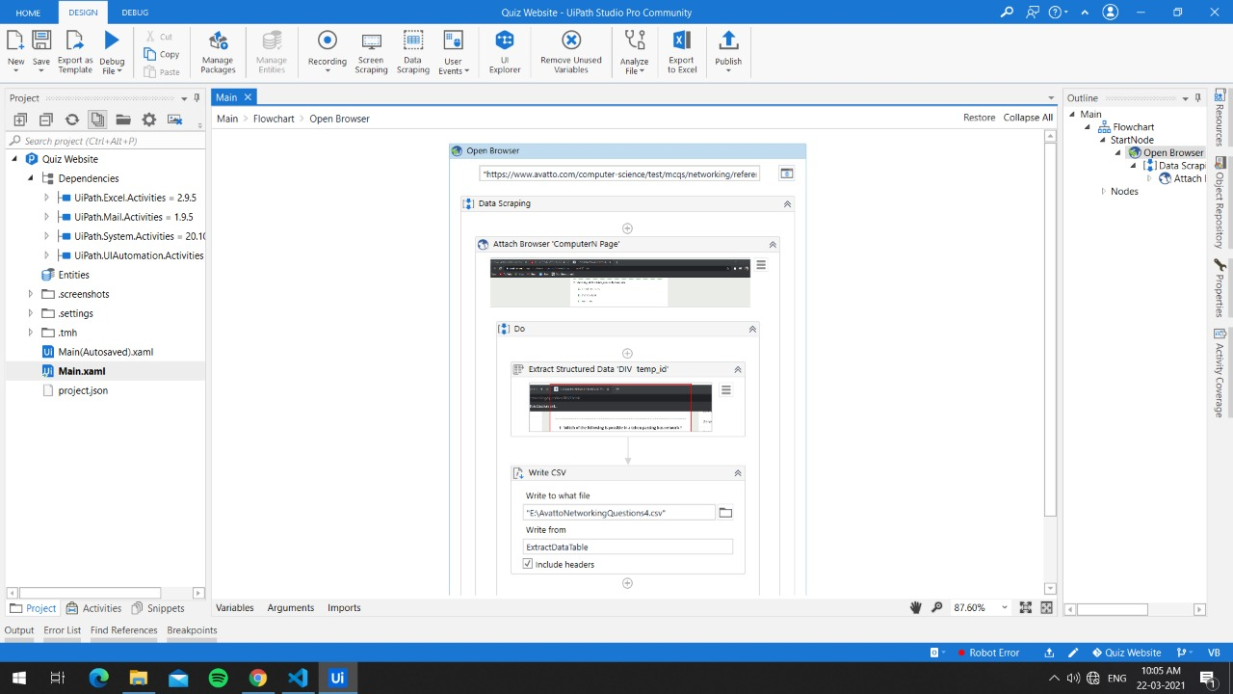

Slide 6
Implementation and Screenshots of User Interface

Slide 7
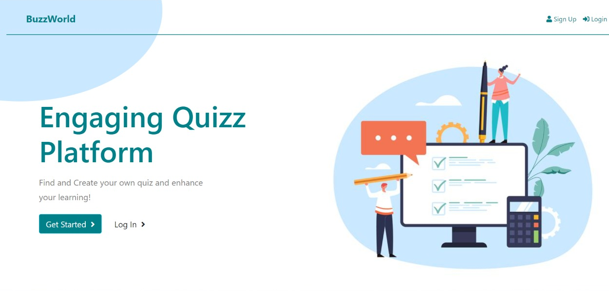
This is the first view of our website or we can say the home page of our website. we prepare a design format for the website of how our website will look like and what functionality will cover which area of the website.

Slide 8
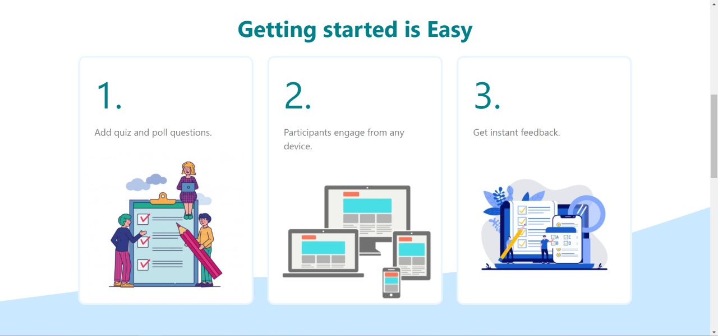
We will work on how all these modules get connected and provide a better interface for interactivity and looks astonishing at the very first sight of the user. The user can create its own quiz or can take part in an online quiz.

Slide 9
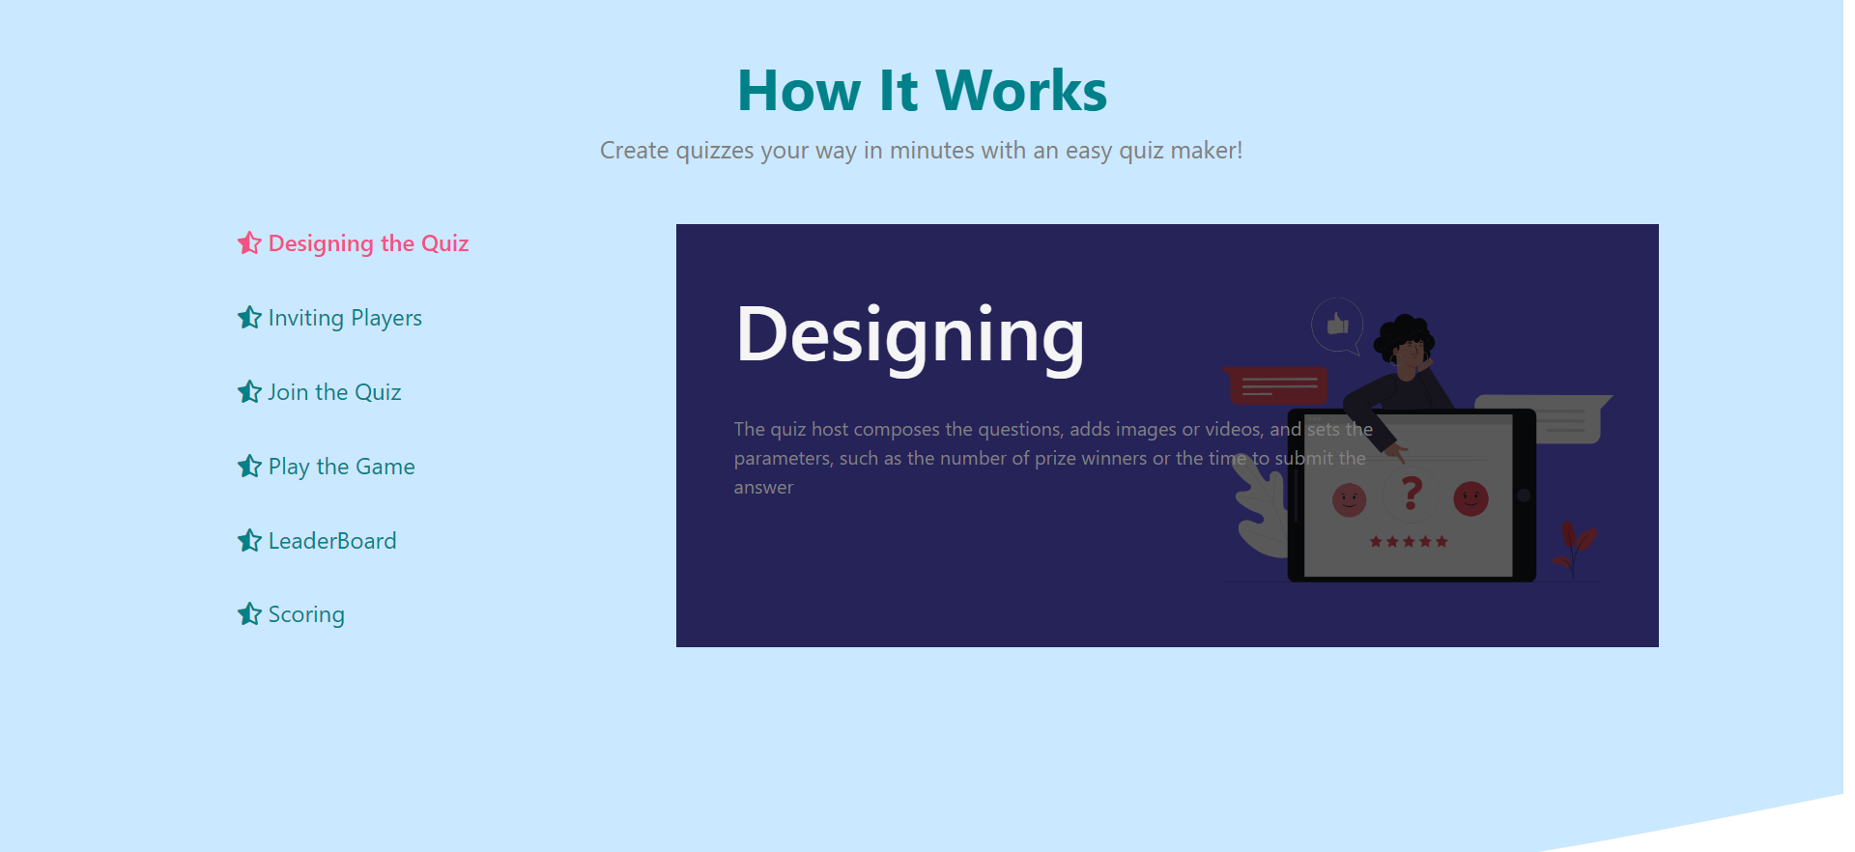
This interface provides various facilities to the user or we can say this interface defines our website motive . The user can design the user, can invite other person to participate in quiz.

Slide 10
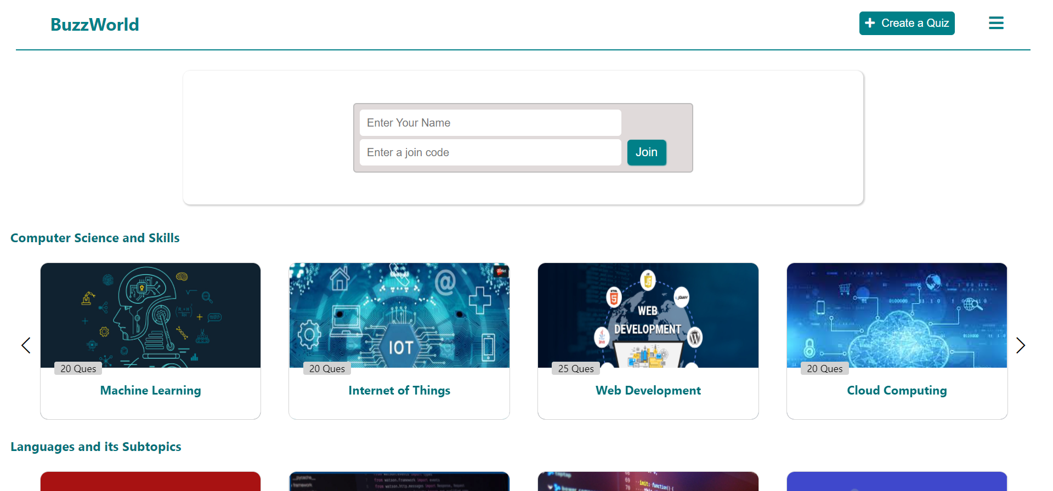
This is the dashboard of our website where we provide several prebuild quiz on several topics to enhance the learning and also an option to create your own quiz with your own choice of questions and to join the live quiz hosted by someone else.

Slide 11
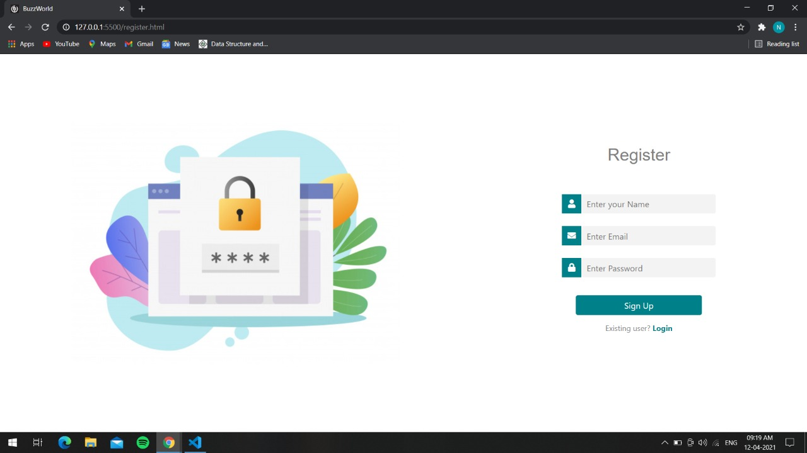
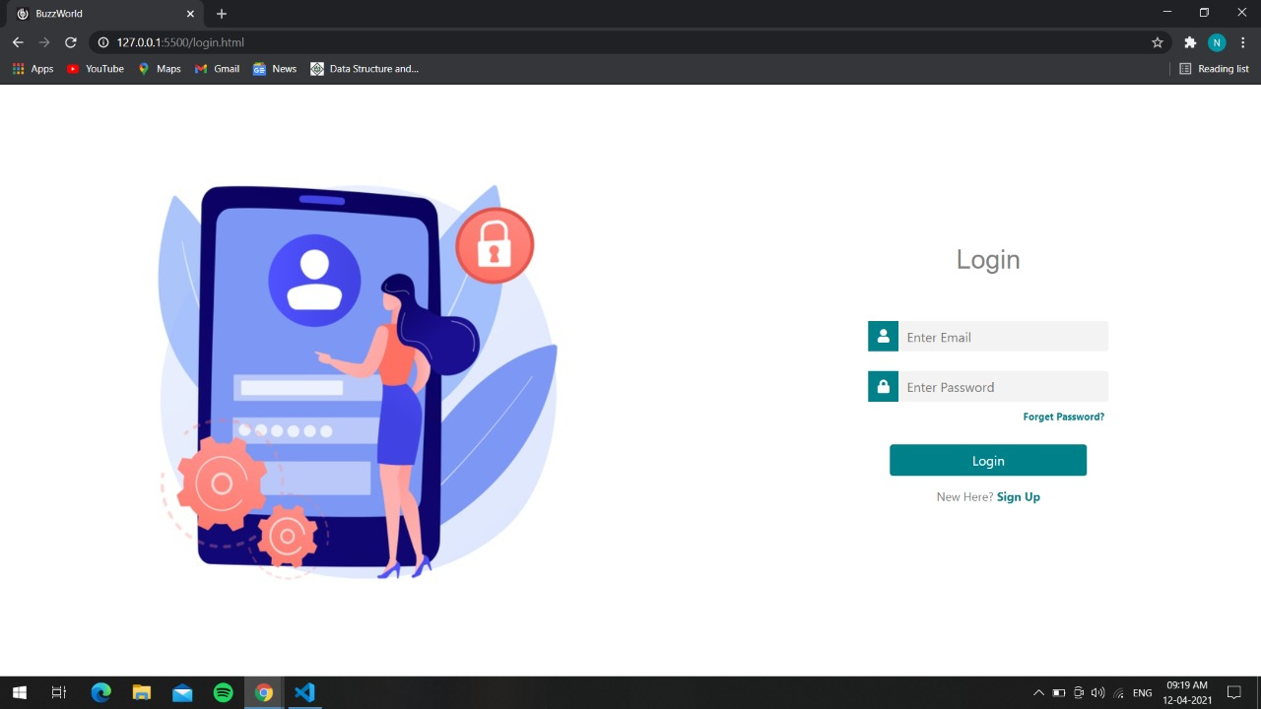
These are the login and register pages

Slide 12
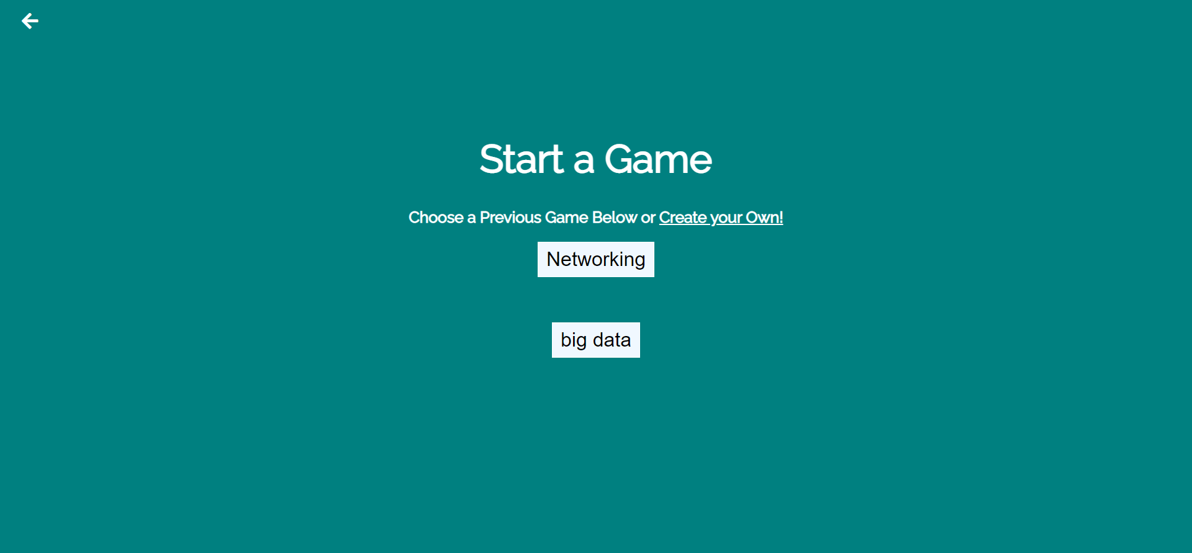
When user clicks on create quiz this page opens up. It has two options whether to select from the previous quizzes or to create a new quiz.

Slide 13
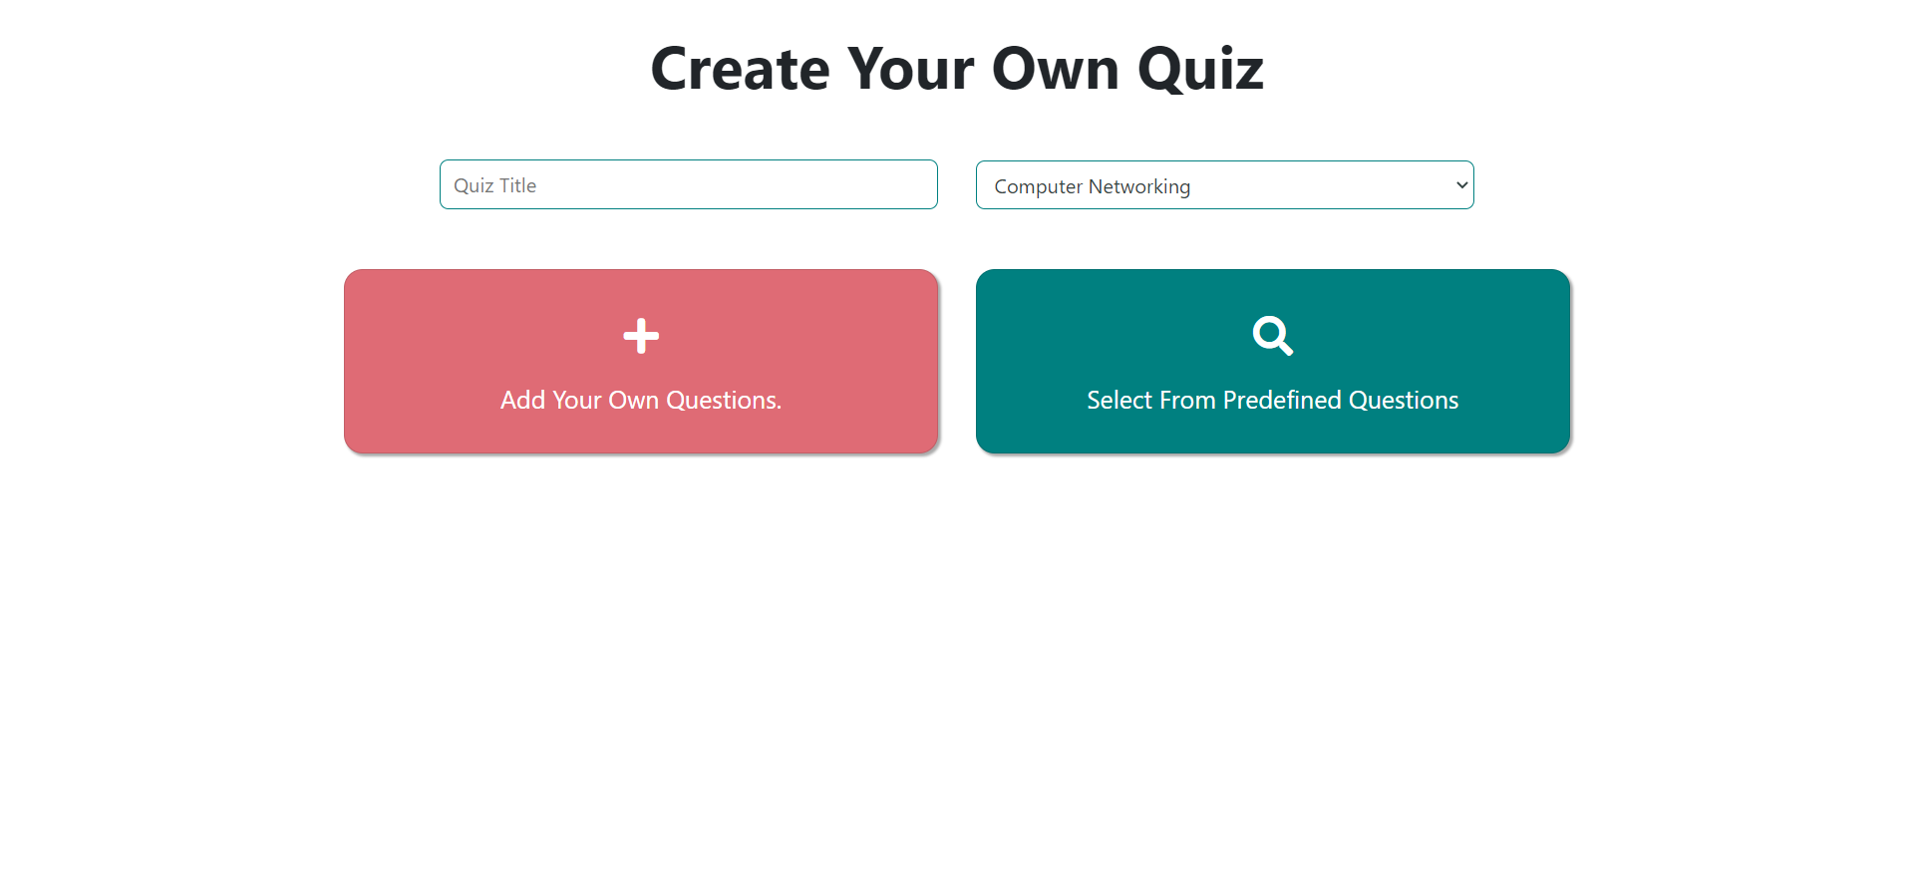
Dashboard for creating quiz with two options

Slide 14
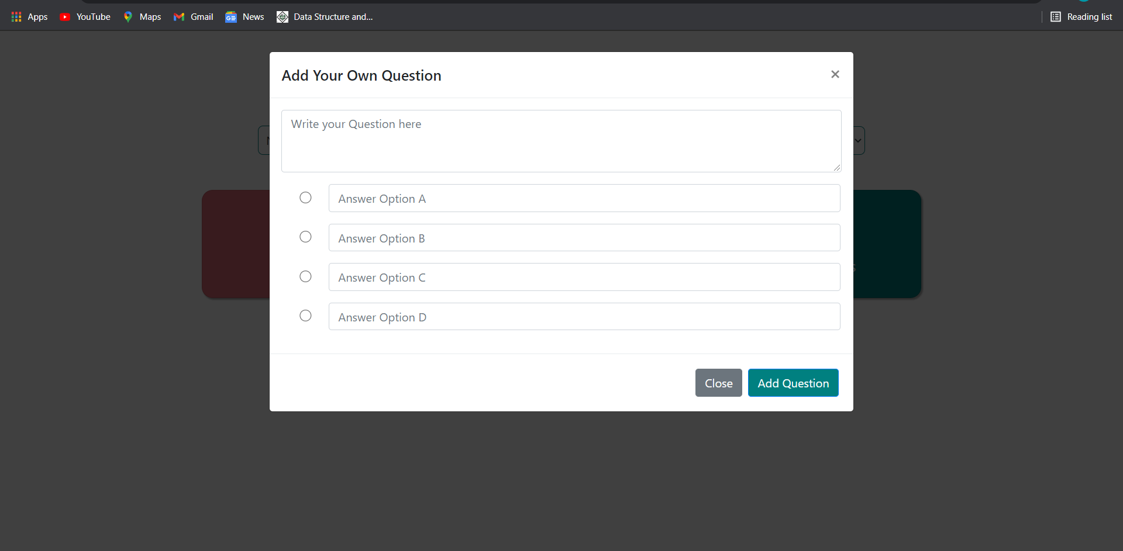
To Add Question By Yourself

Slide 15
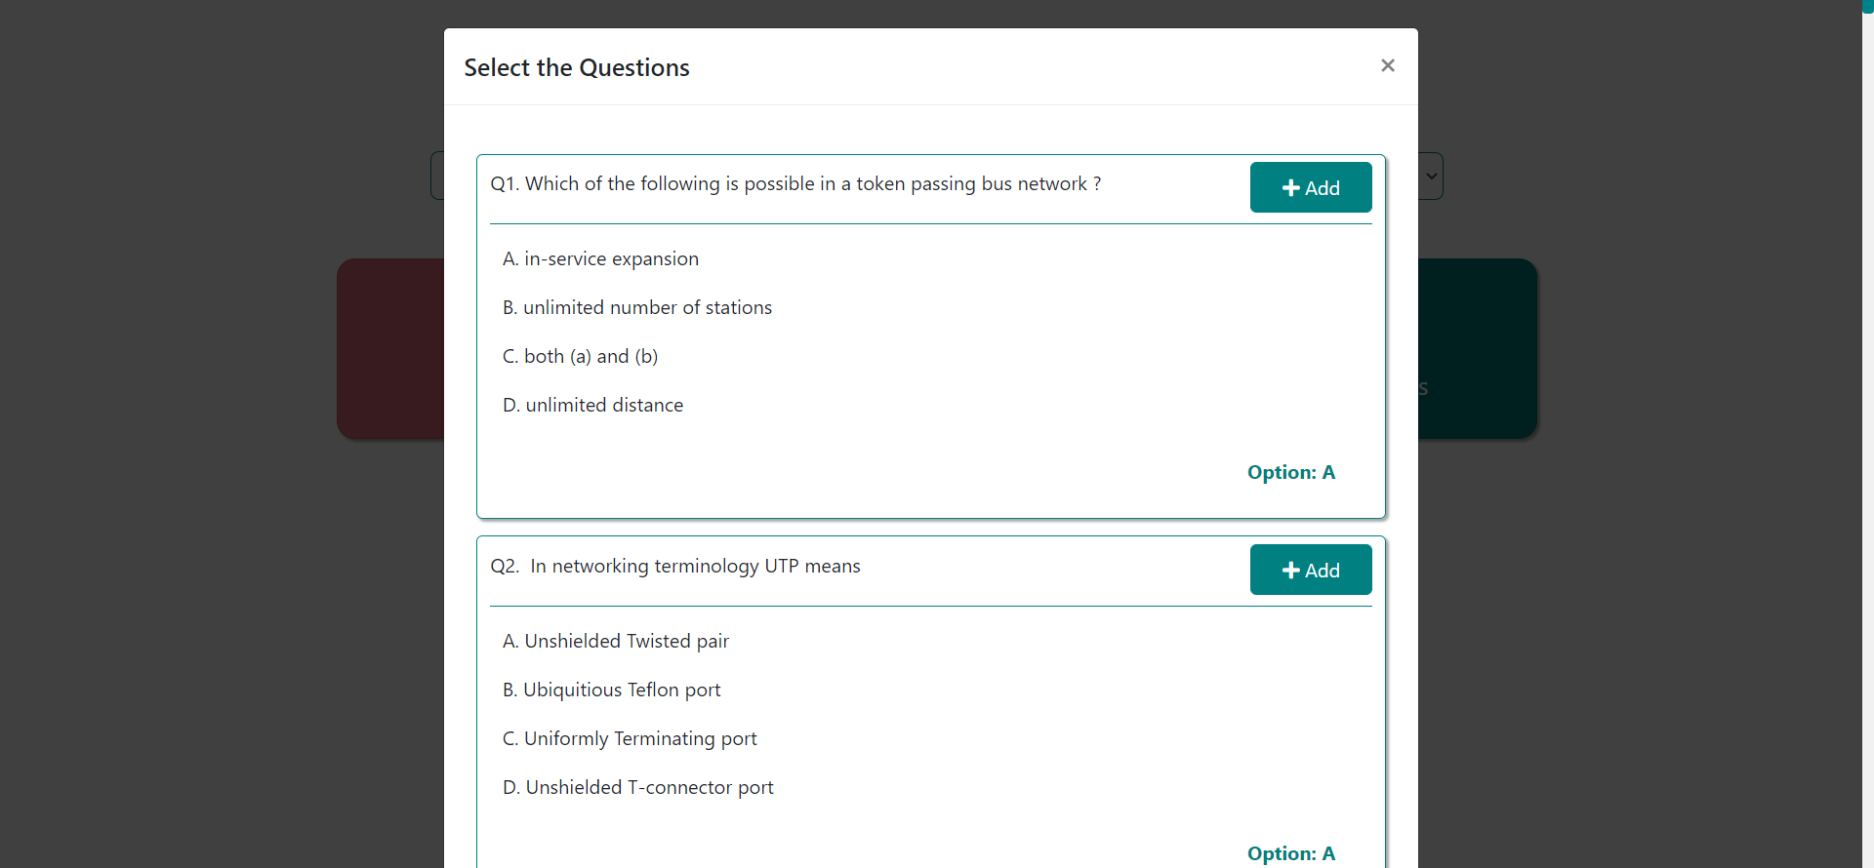
Choose Your Predefined Set Of Questions from different topics

Slide 16
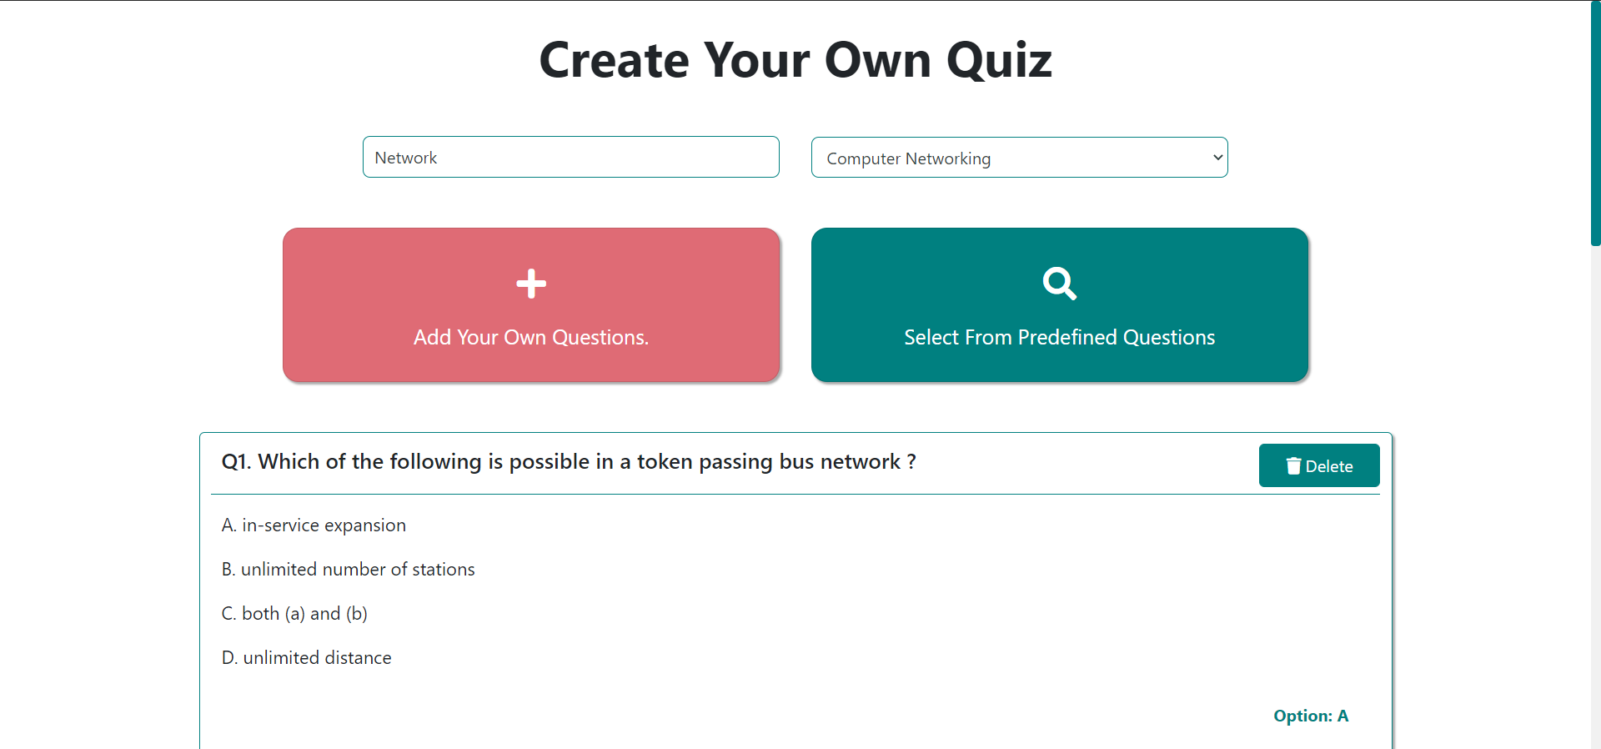

Slide 17
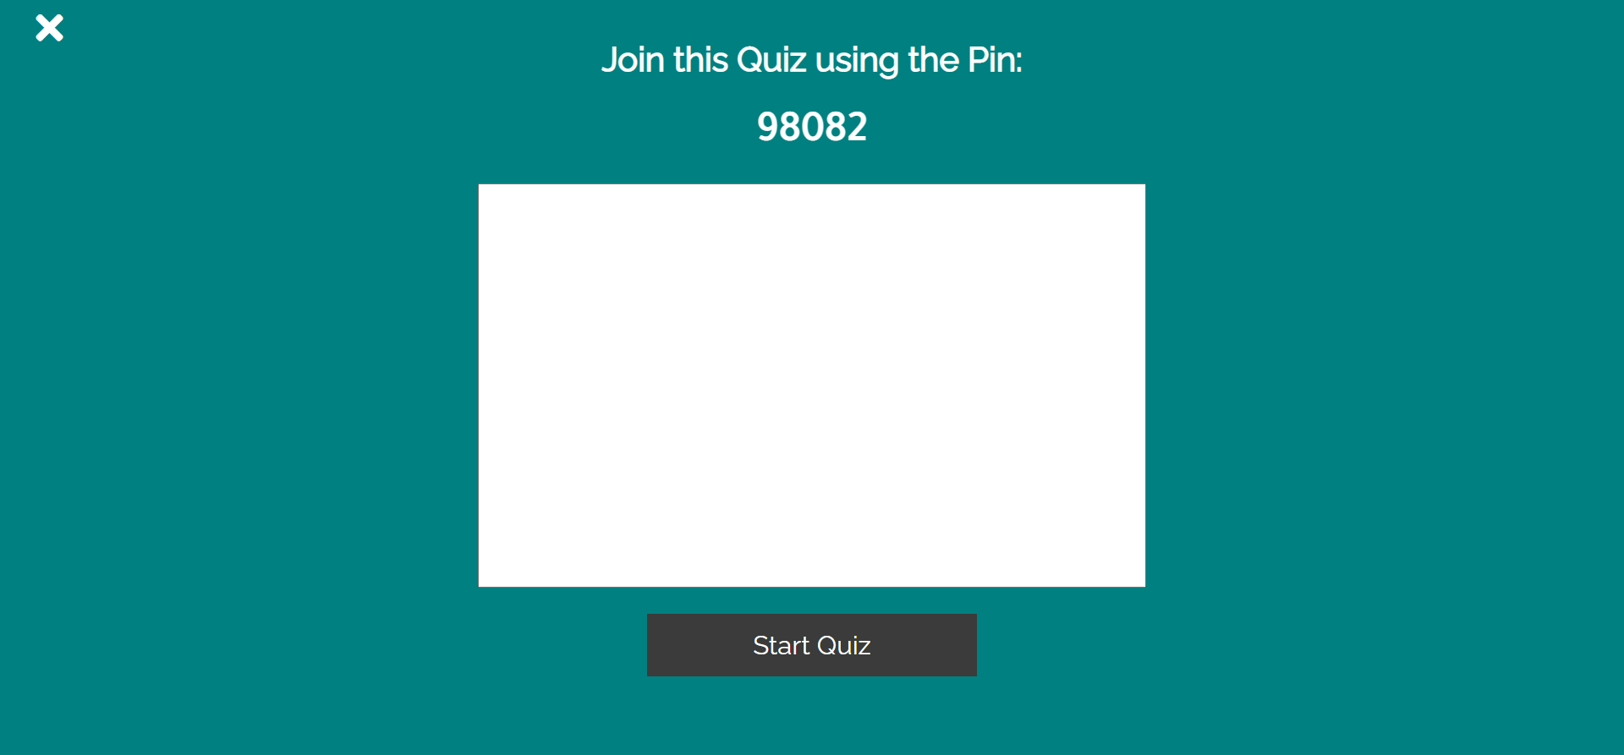
There is a random code generated so that the players can access the live quiz by entering this code. The name of the players will be in the white box. And after clicking start quiz, the quiz will be started.

Slide 18
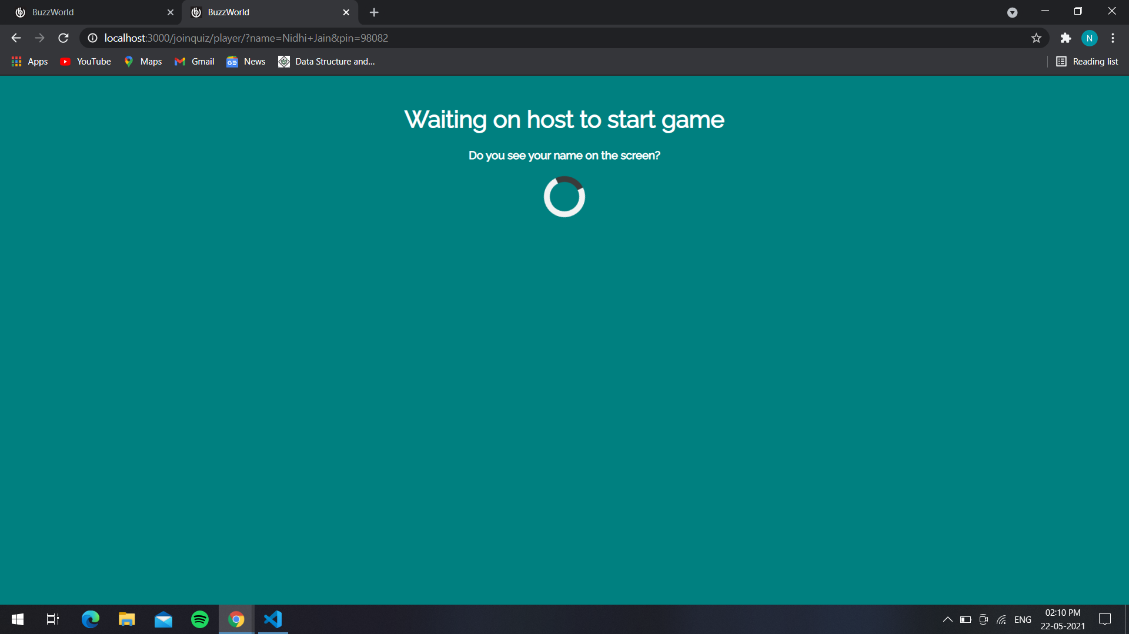
This is the page on players side while waiting for the host to start the quiz.

Slide 19
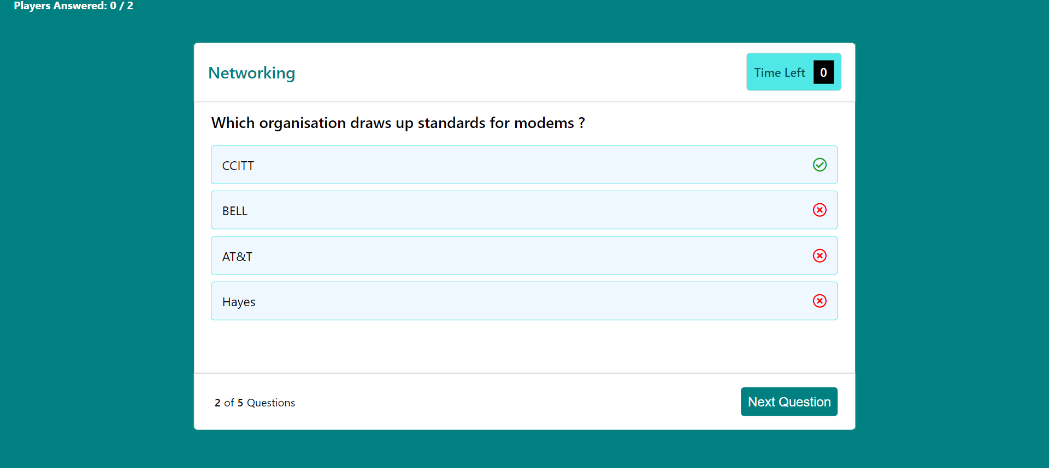
When host click on next question then next question will be displayed on player side

Slide 20
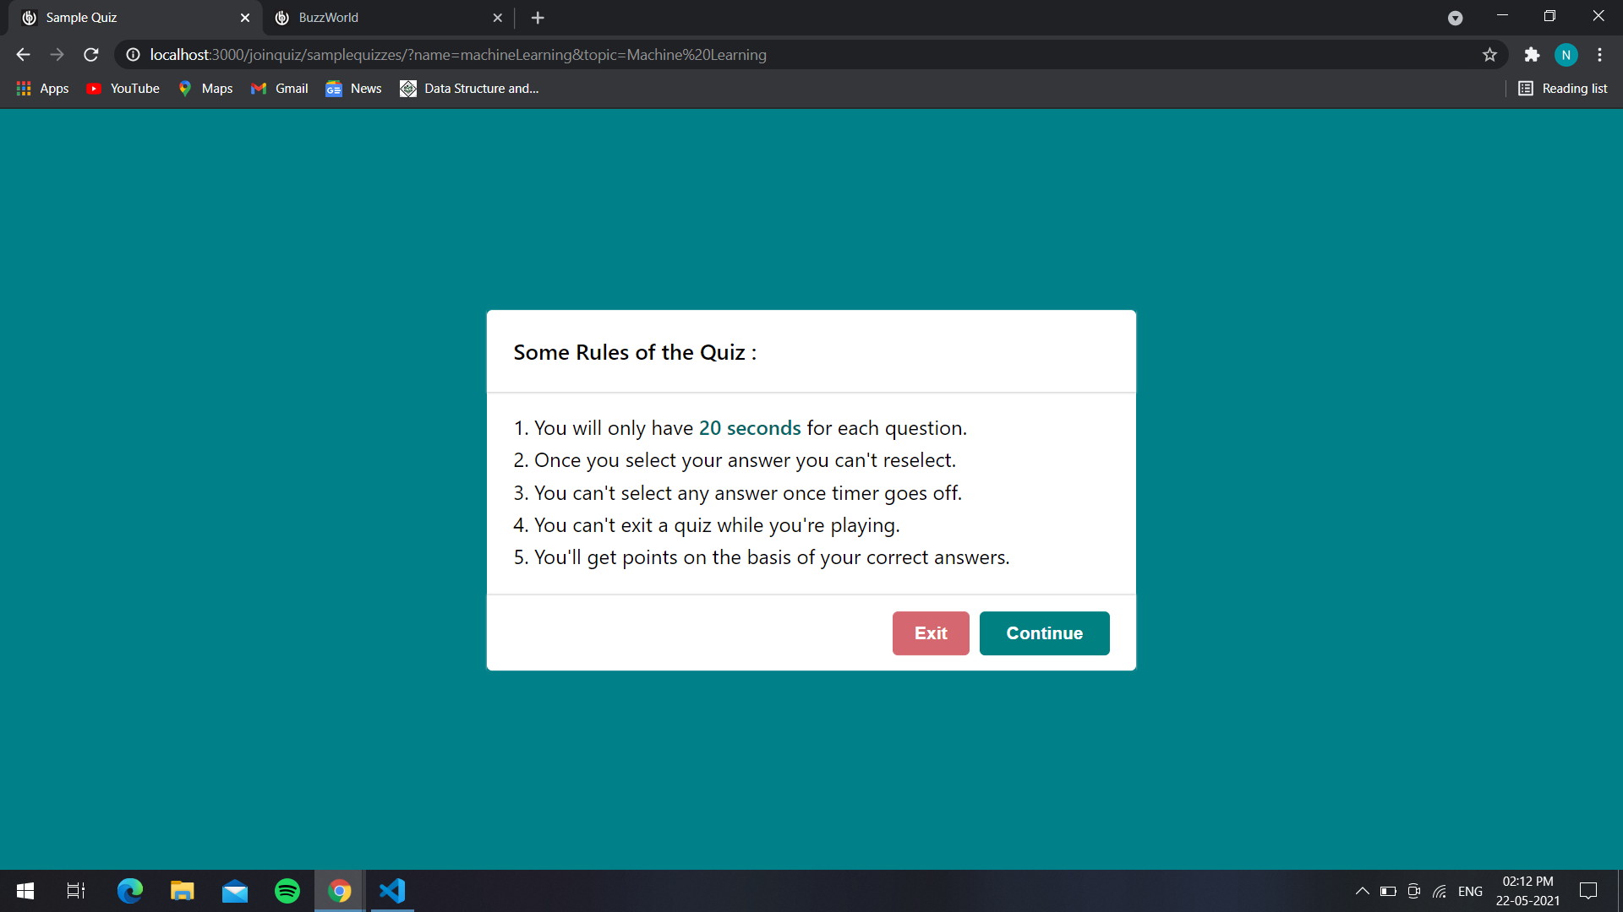
Instructions for taking the sample quiz.

Slide 21
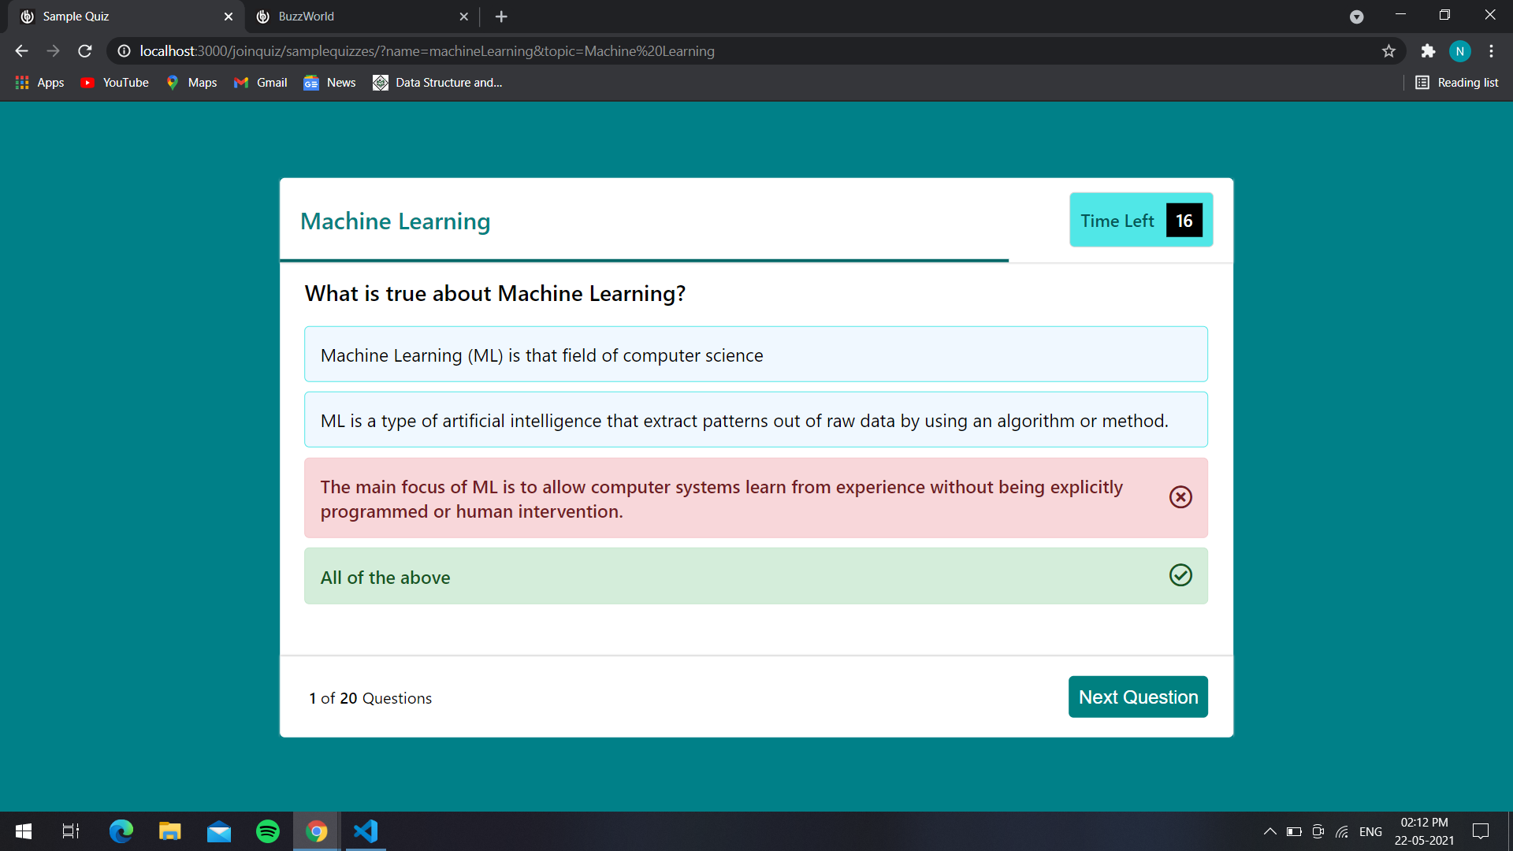
Questions with timer and user need to click on the correct answer.
If the answer clicked by the user is wrong then it will be crossed and the correct answer will be highlighted.

Slide 22
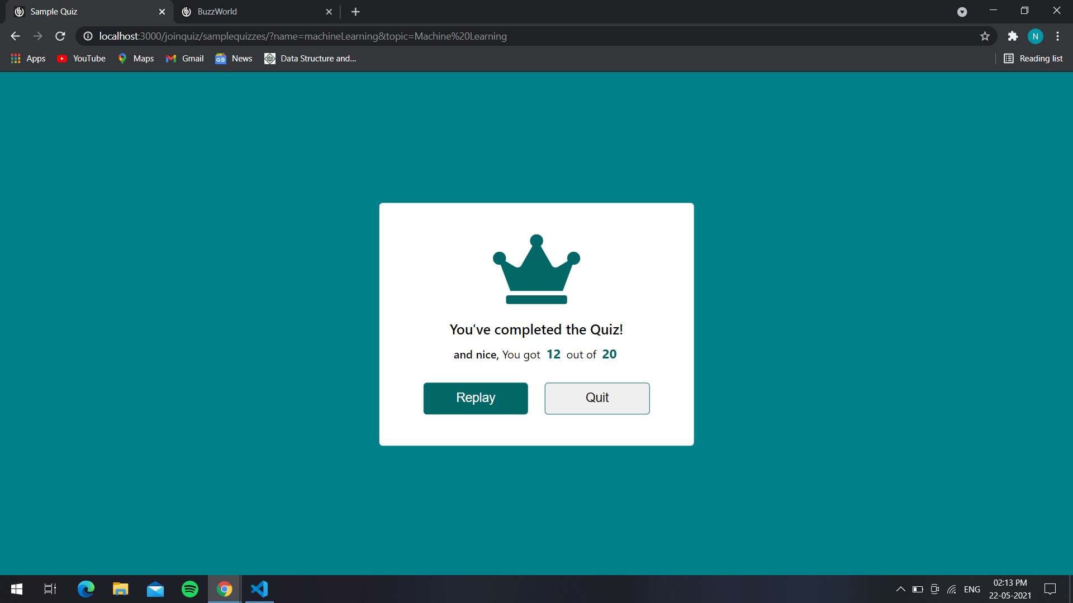
This is the result page after completion of the sample quiz.

Slide 23
Thank YOU

